Slide 1
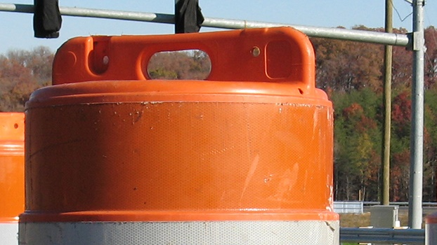
Road Safety
Assessing Safety Challenges
Greg Driskell
PPP, Inc.
Greg.Driskell@pppcatalog.com

Slide 2
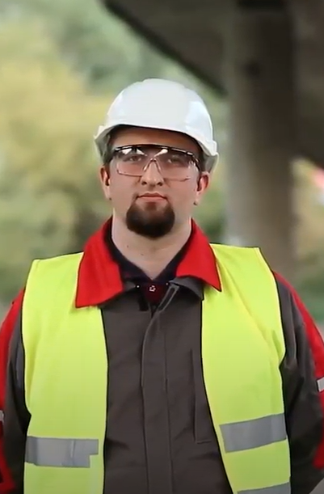
User
Worker

Slide 3
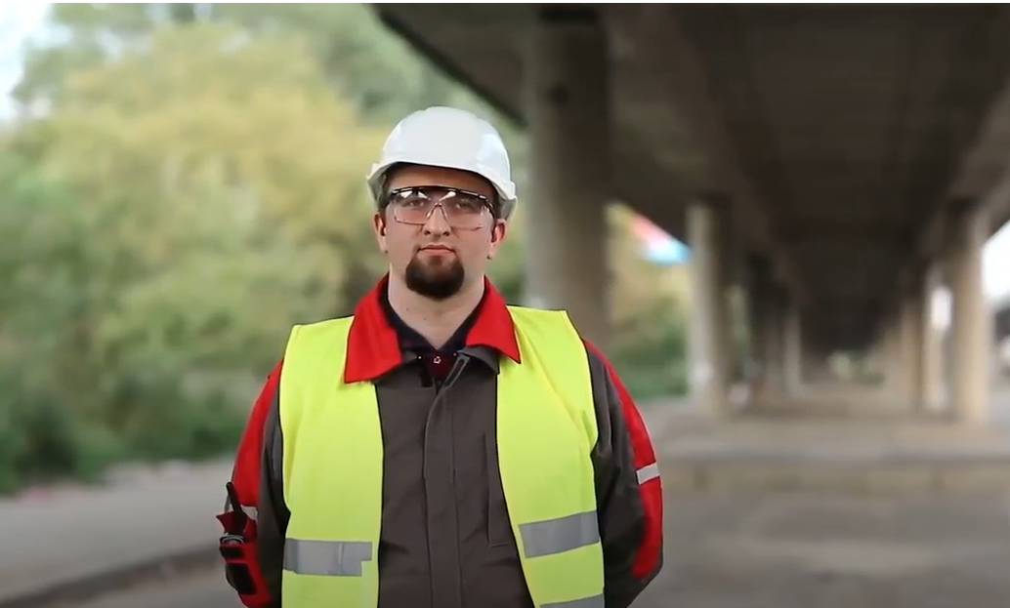
Worker

Slide 4
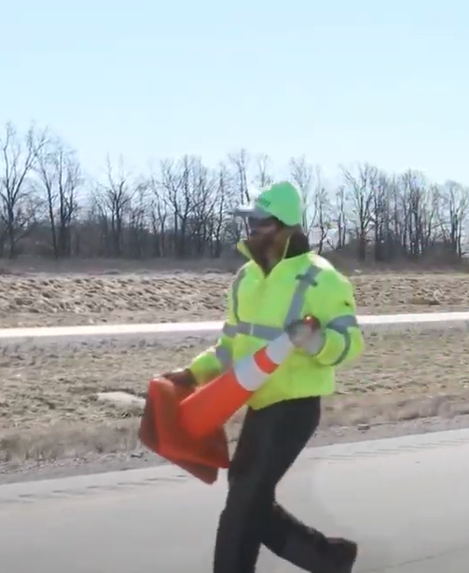
Prevention
Protection

Slide 5
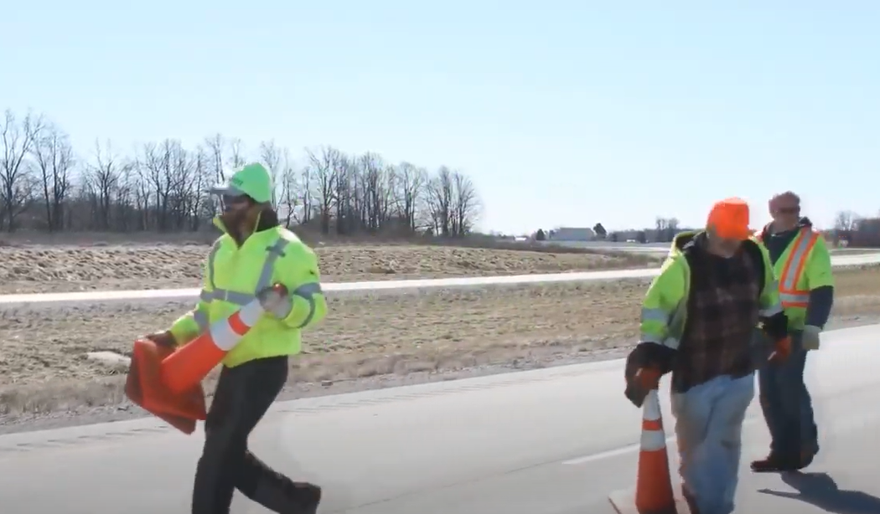
Prevention

Slide 6
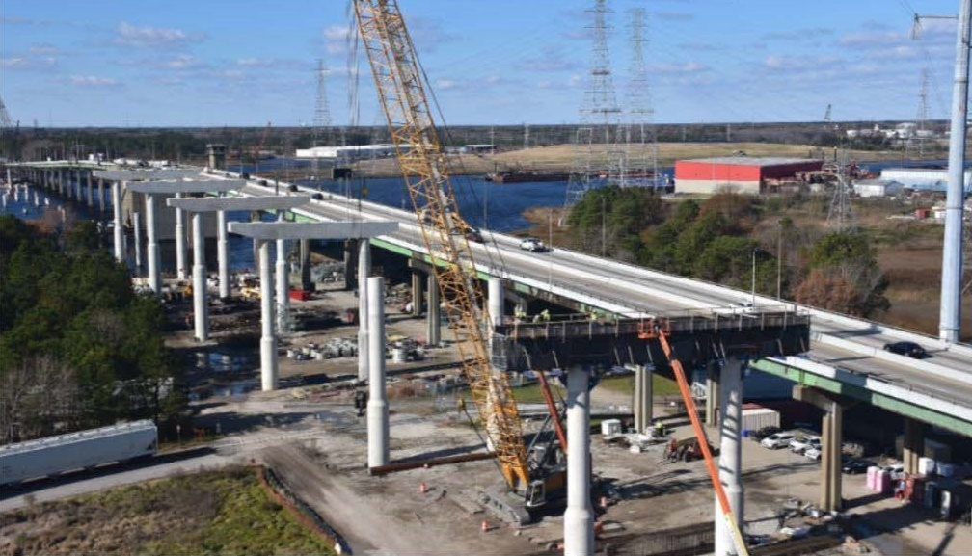
Maintenance and Construction

Slide 7
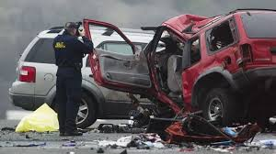
Fatalities

Slide 8
Distracted Driving

Slide 9
Safety Costs

Slide 10
Necessary Evil?

Slide 11
Focus

Slide 12
Paradigm Shift

Slide 13
Uniformed

Slide 14
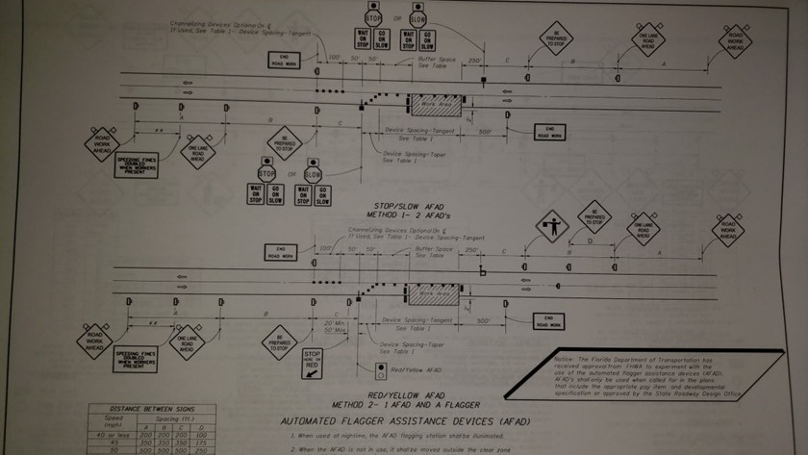
Better than the Basics

Slide 15
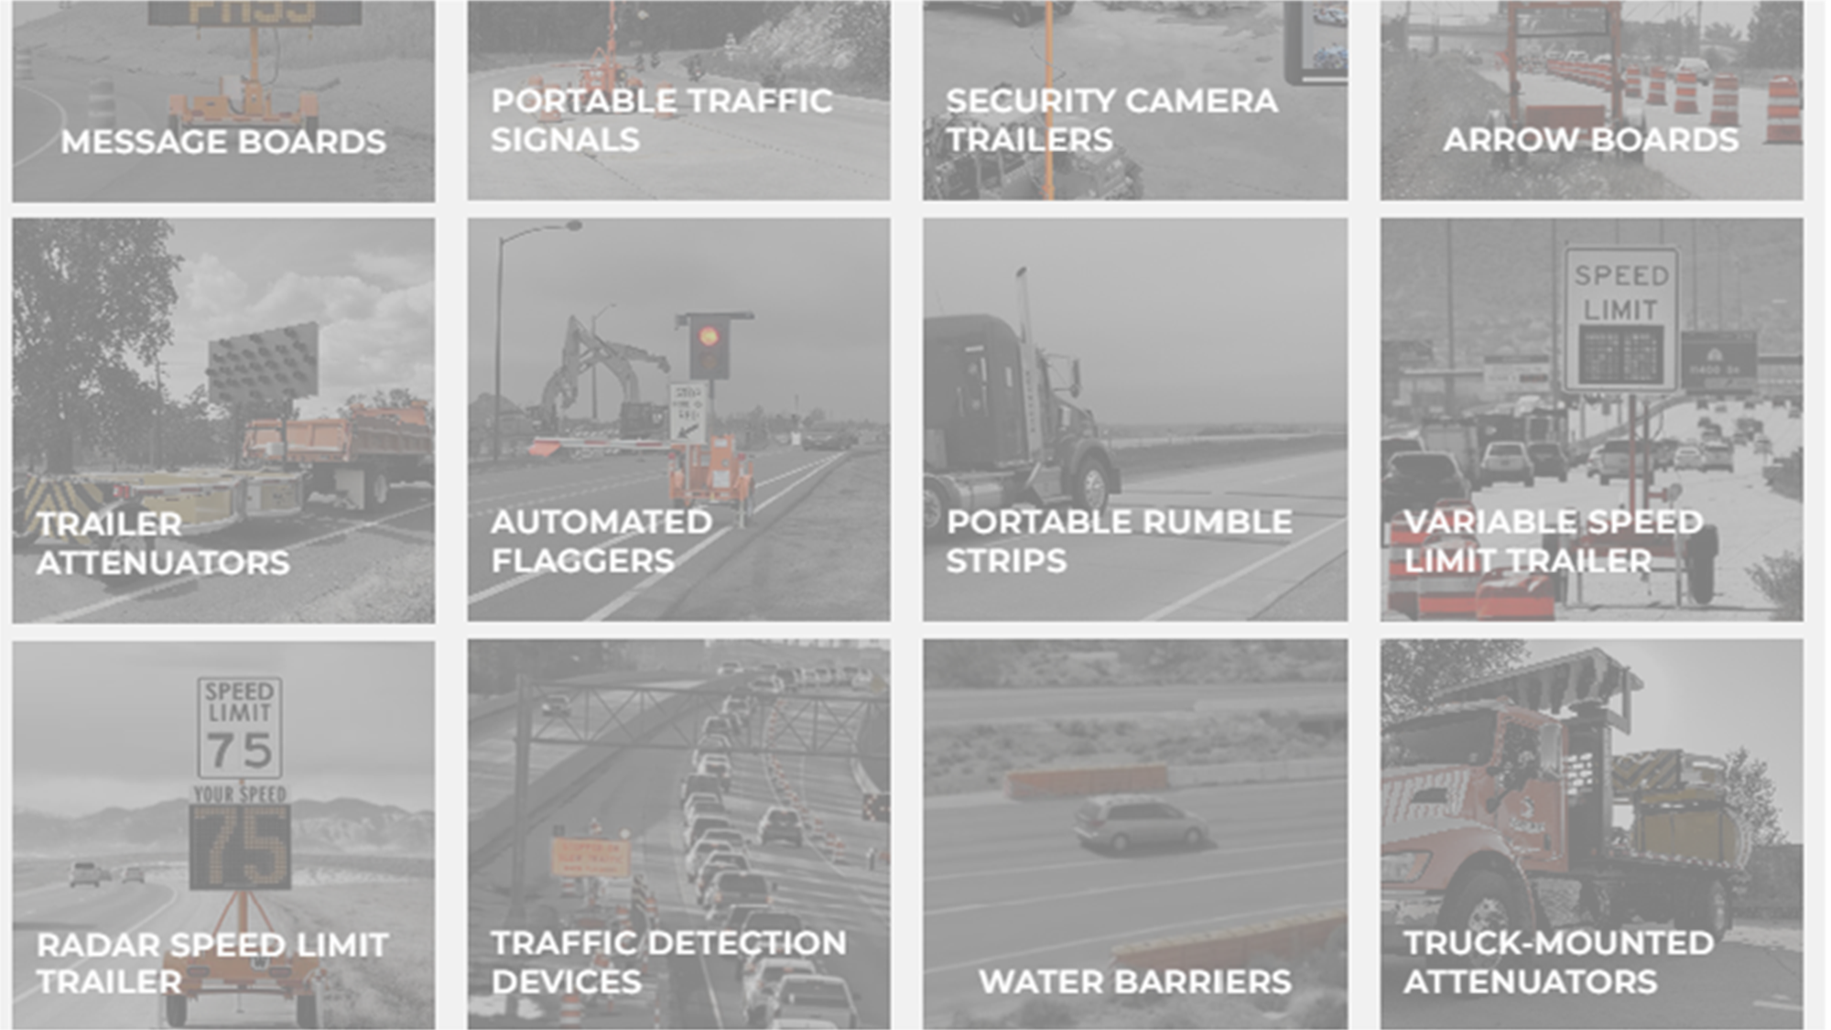
Better Innovative Technologies

Slide 16
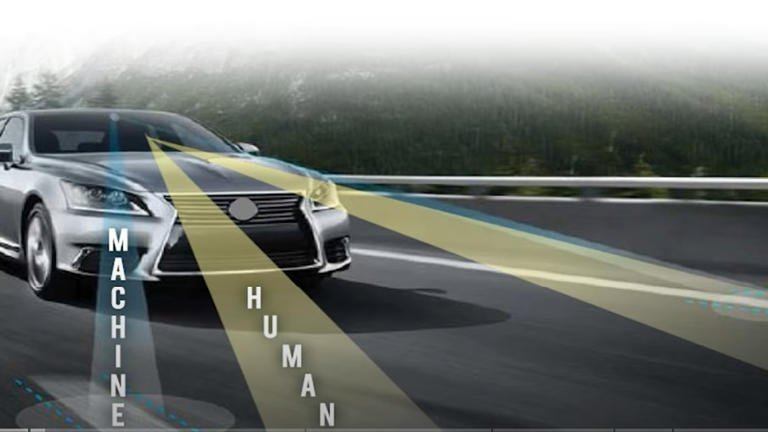
Development or Pilot Deployment

Slide 17
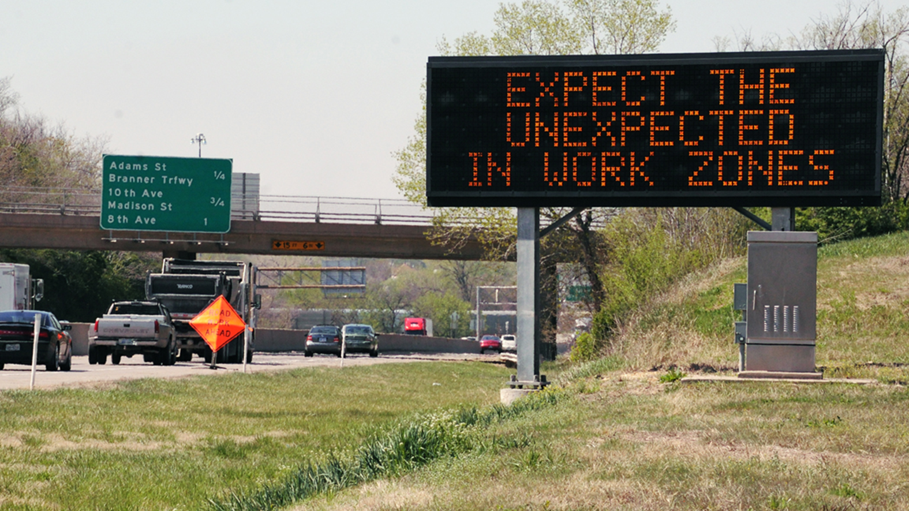
Deployed Communication Innovations

Slide 18
Deployed Equipment and Devices

Slide 19
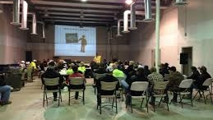
Better Training

Slide 20
Better Funding

Slide 21
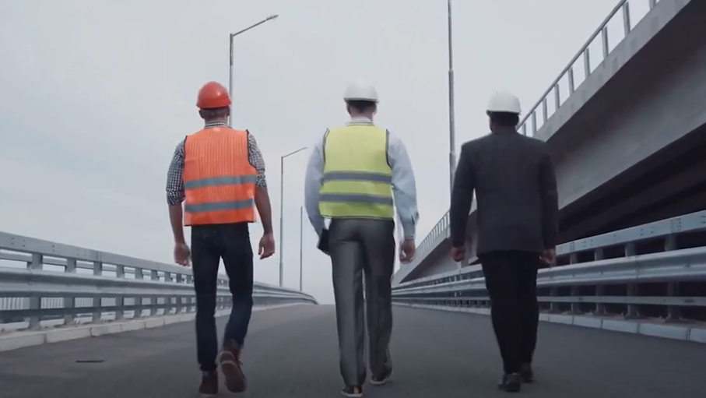
Personal Responsibility

Slide 22
Road Safety
Greg Driskell
PPP, Inc.
Greg.Driskell@pppcatalog.com

